Slide 1
Is EEG better left alone for decoding?
Roman Kessler, Alexander Enge, Michael A. Skeide

Slide 2
Background
Decoding on EEG signal is widely used, e.g.,
to delineate representational geometry of a stimulus set
in brain computer interfaces
Multiverse preprocessing has been deployed for EEG to
assess robustness of results,
limit the researcher’s d.o.f.,
find optimal preprocessing steps to maximize, e.g., ERP amplitude
We use multiverse preprocessing to investigate the impact of single steps on decoding performance across different paradigms.
Notes:
Speaker notes go here.

Slide 3
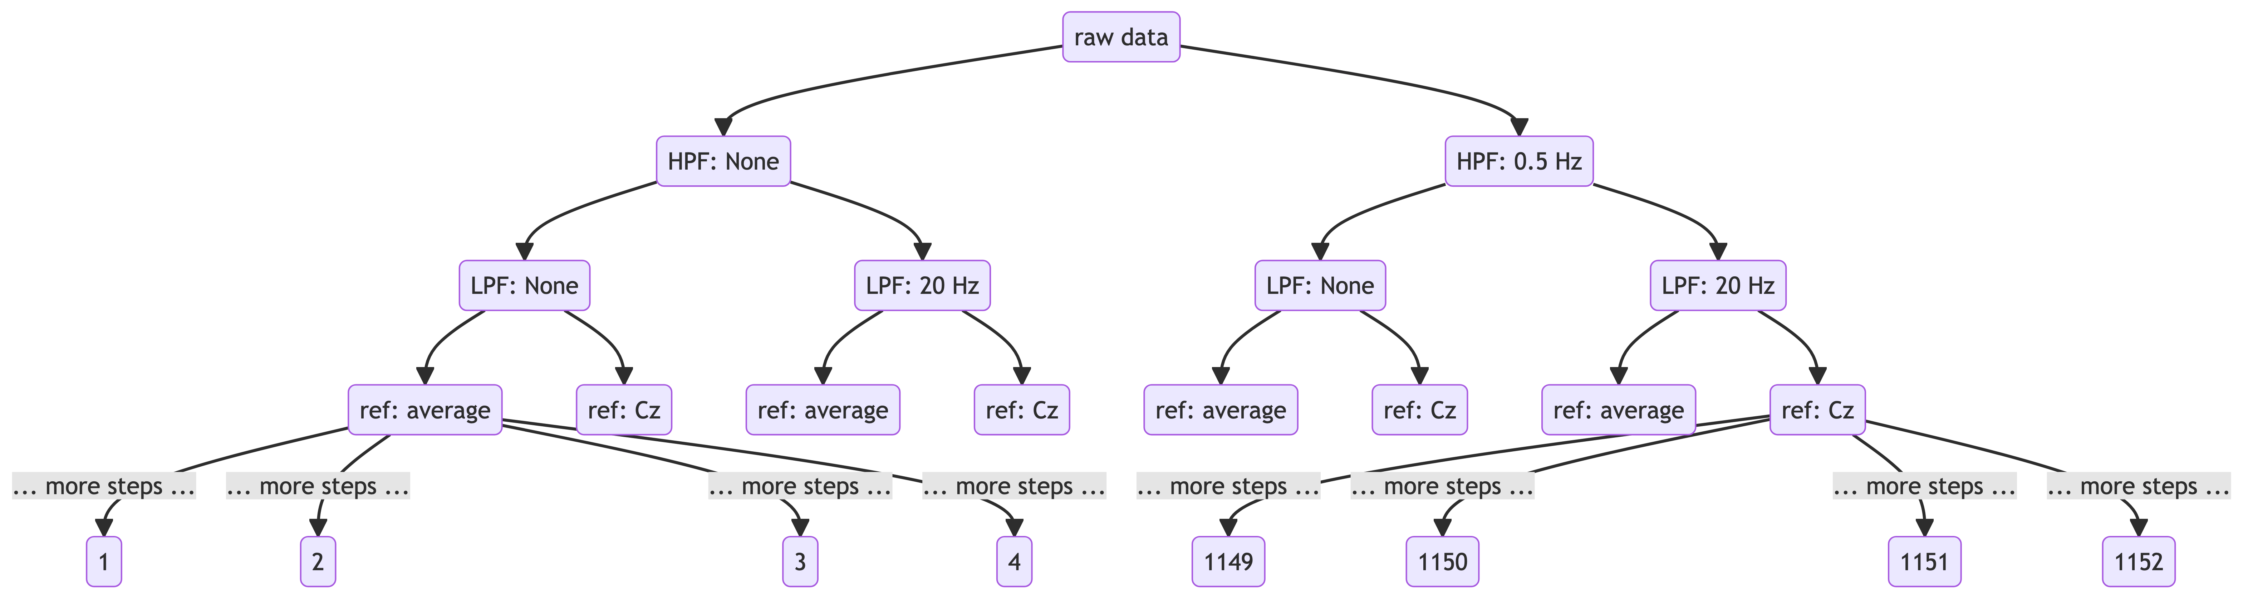
A multiverse for preprocessing

Slide 4
Combination of different processing steps leads to 1152 possible versions of preprocessed EEG signals.

Slide 5
Data
7 experiments from the ERPCORE dataset

Slide 6
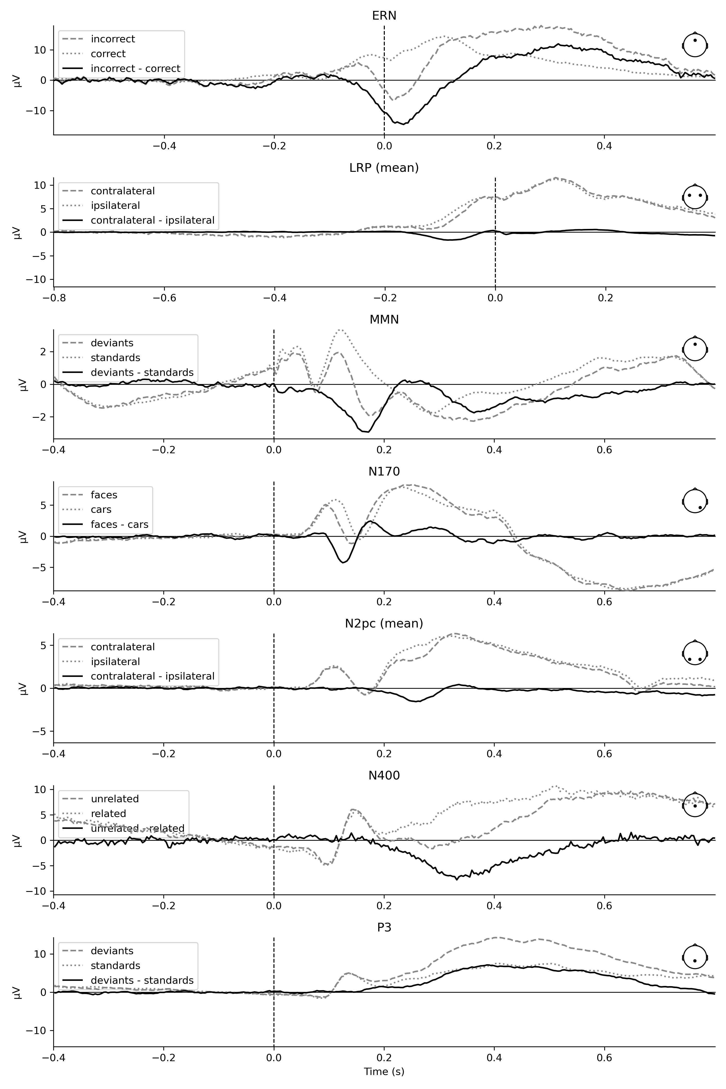
ERPs (one forking path)

Slide 7
Decoding approaches
Neural Network-based (EEGNet)
Cross-validated (balanced) test accuracy within one forking path
for each participant
for each experiment
Time-resolved using Logistic Regression
Cross-validated (balanced) test accuracy per time point within one forking path
Significant (FWE corrected) clusters identified using cluster-based permutation tests across all participants
Tsums quantified from significant clusters
for each experiment

Slide 8
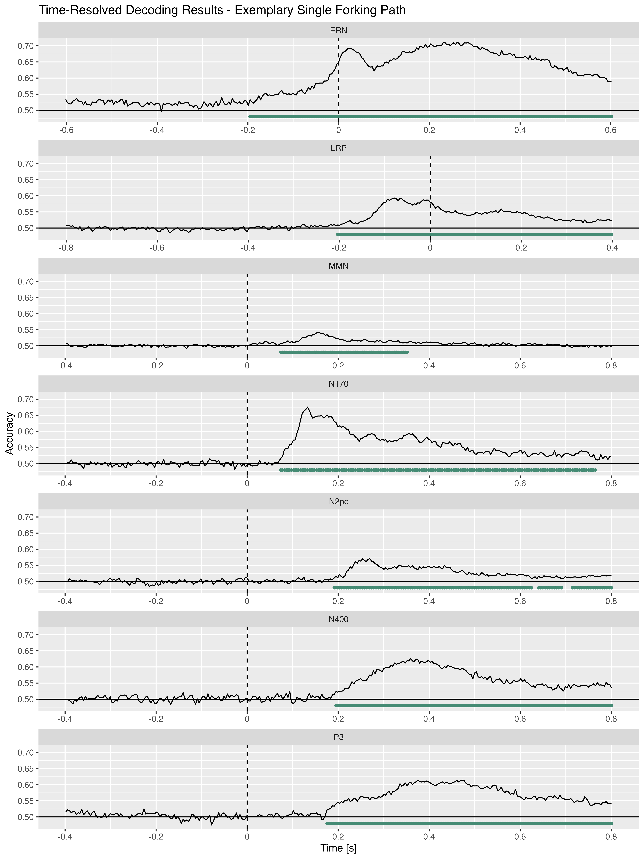
Time-resolved decoding (one forking path)

Slide 9
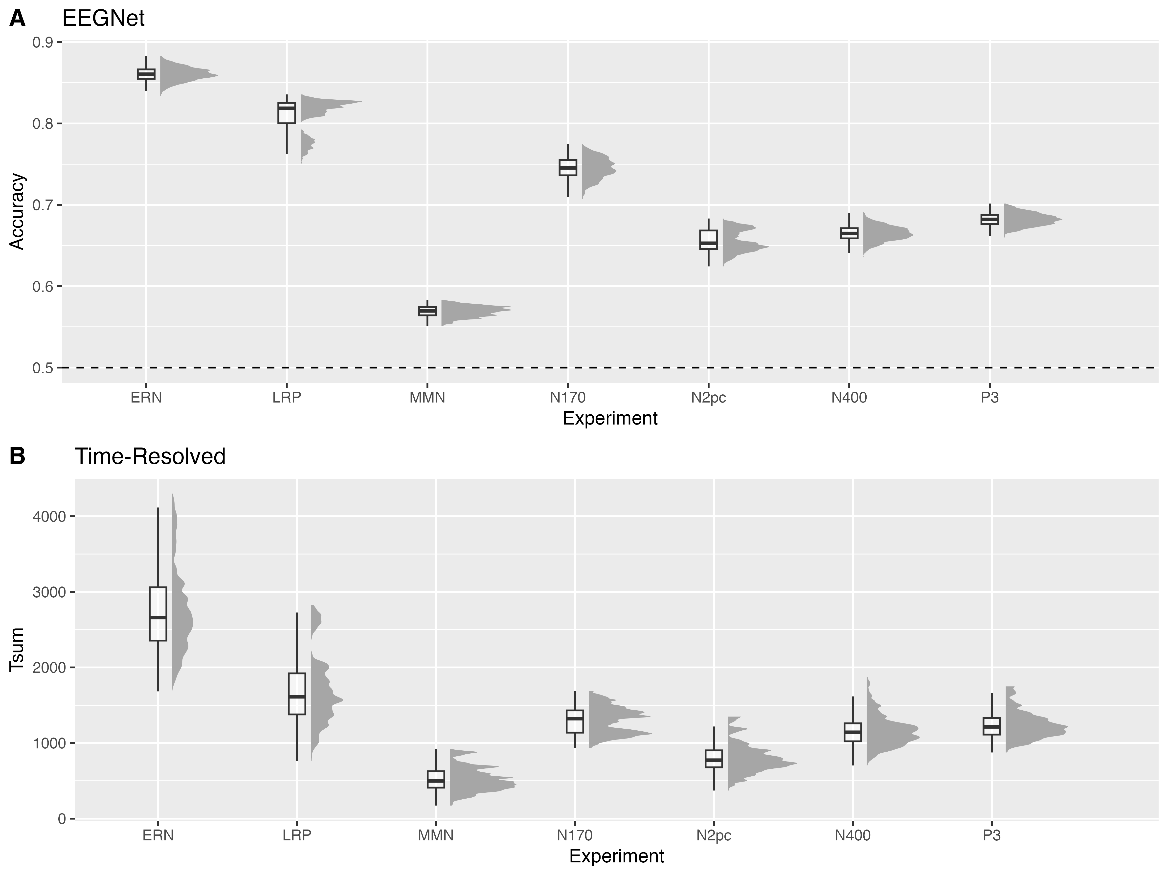
Overview of decoding performances

Slide 10
Modeling the impact of the analysis steps on decoding accuracy
EEGNet, Linear Mixed Model
$$ \text{accuracy} \sim\\ 1 + (\text{hpf} + \text{lpf} + \text{ref} + \text{emc} + \text{mac} + \text{base} + \text{det} + \text{ar}) ^ 2 \\ + (1 + (\text{hpf} + \text{lpf} + \text{ref} + \text{emc} + \text{mac} + \text{base} + \text{det} + \text{ar}) ^ 2 |\text{sub}) $$
Time-resolved, Linear Model
$$\text{Tsum}∼1+{\left(\text{hpf}+\text{lpf}+\text{ref}+\text{emc}+\text{mac}+\text{base}+\text{det}+\text{ar}\right)}^{2}$$
→ Estimate marginal means and contrasts

Slide 11
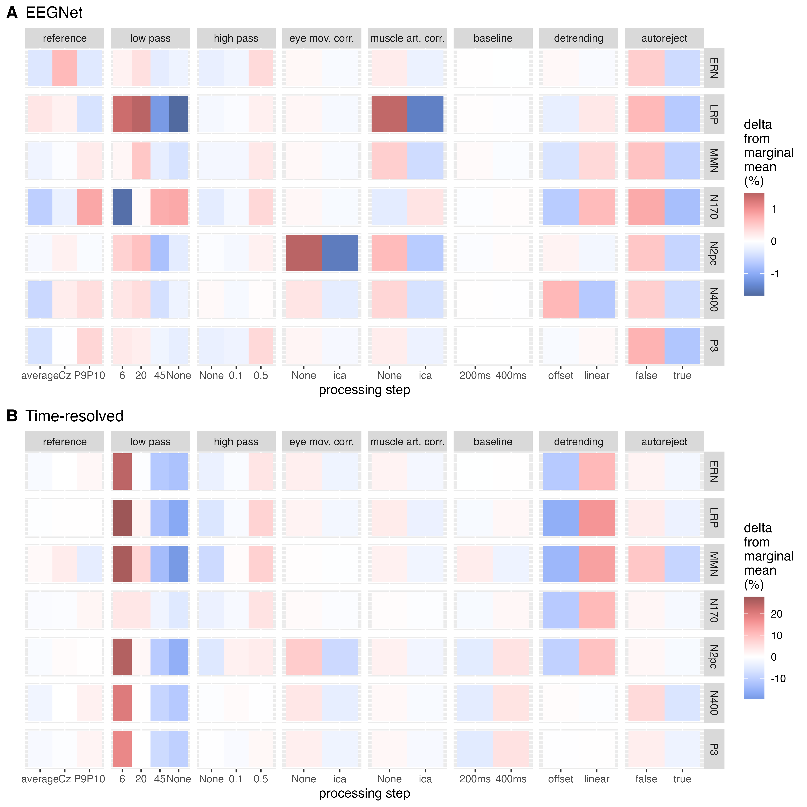
Marginal means
main effects

Slide 12
Marginal means
EEGNet
very small effects on decoding percormance (accuracy)
filters are learnt well independent of preprocessing
different optimal processing steps for each experiment
all artifact removal methods decrease performance
Time-resolved
larger effects on group level decoding performance (Tsum)
similar optimal processing steps for each experiment
narrow filtering (0.5 - 6 Hz) optimal
all artifact removal methods decrease performance

Slide 13
Marginal means
interactions
experiment: ERN
EEGNet

Slide 14
Marginal means
interactions
experiment: ERN
time-resolved

Slide 15
Discussion
comments on current methods & results
what should be analyzed in addition for the current purpose?
should p values be of interest?

Slide 16
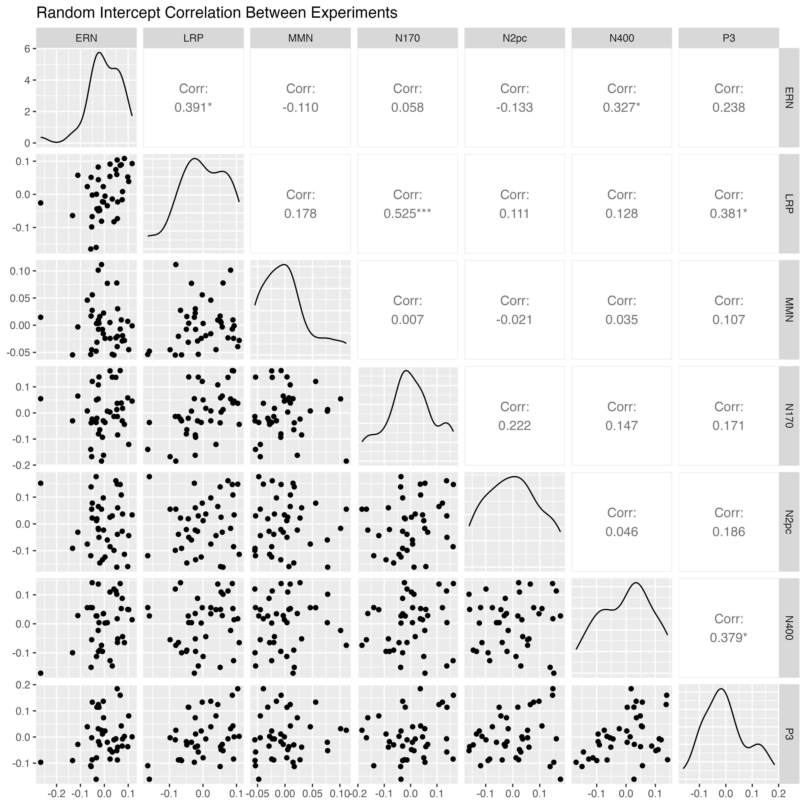
Participant demographics

